Slide 1
Lecture 21: Polymorphism
Pretty polymorphism.

Slide 2
Java
We have now covered the "core" of Java.
We have three remaining things to do:
Explore the (vast) library of classes available in Java.
Explore ways to develop more sophisticated object interactions.
Discuss Methodology and structured programming
Remember that the "trick" in programming is to spot patterns.

Slide 3
Before We Start: The Assignment
Read the Spec.
Design first.
Start small.
Iterate: build gradually.
Test as you develop (and test your mate's).
Use online sources (StackOverflow is your friend).
Think about the demo (test data).
Get feedback.

Slide 4
Source Code Control
Your final system will probably consist of many source
code files.
And as you program you will generate many versions of these files.
You will need to have some sort of control over these versions. Learning a little about this has the potential to save a lot of pain.

Slide 5


Slide 6
Git
Long ago, we touched on Git.
Storing your assignment code in Git (on GitHub, GitLab, etc.) has the potential to save you a lot of pain.
Git can be used from the command-line, or via a GUI.
Good editors (Atom) and IDEs (IntelliJ, Eclipse) offer integration with Git.
There are also good standalone GUIs: GitKraken.

Slide 8
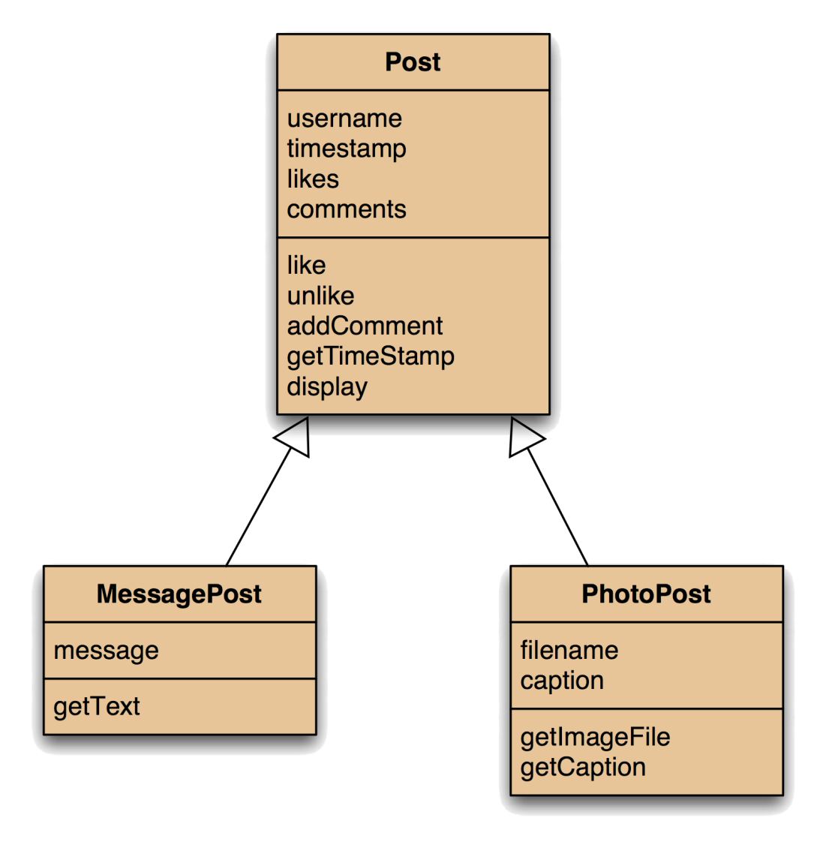

Using Inheritance

Slide 9
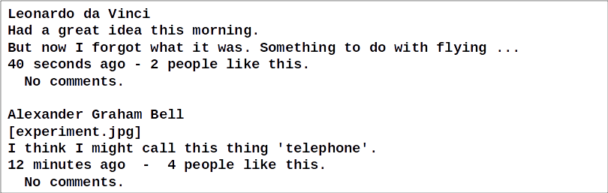
The Problem
We want output like this, with slightly different display for the two Post types.

Slide 10
Inheritance So Far
Inheritance helps reduce code duplication.
Classes define types. Subclasses define subtypes.
Substitution:
Objects of subclasses can be used where objects of superclasses are required.
Object variables are polymorphic:
They can hold objects of more than one type.

Slide 11
Today's Topics
Today we extend our knowledge of inheritance to include:
Method Polymorphism.
Static and Dynamic Type.
Overriding.
Dynamic Method Lookup.
Protected Access.
Abstract Methods.

Slide 12
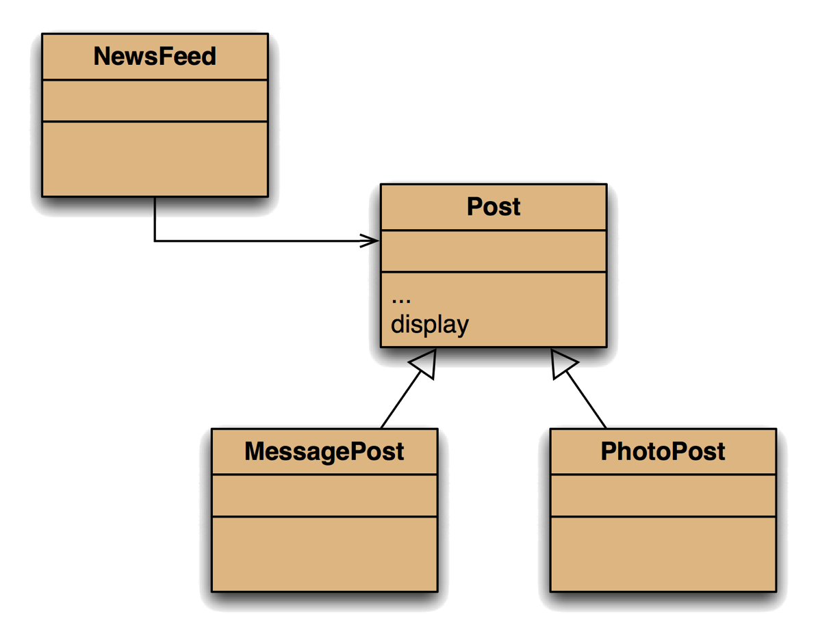
The Inheritance Hierarchy
MessagePost and PhotoPost inherit all the methods from Post.
They inherit all the instance variables too, but they can only access the public parts directly.

Slide 13
The Inheritance Hierarchy
Our problem all along has been that the display method needs to be different for the two types of Post.

Slide 14
The Problem
Post knows nothing of MessagePost and PhotoPost.
So the display method there cannot use any instance variables from the subclasses.
So, with this hierarchy, it can display only the common instance variables: author, likes and comments.
And it displays the same for both types of post.

Slide 15
The Problem
The display method in Post prints only the common
fields.
Inheritance is a one-way street:
A subclass inherits the superclass fields.
The superclass knows nothing about fields in the subclass.
(This is, of course, precisely what we want.)

Slide 16
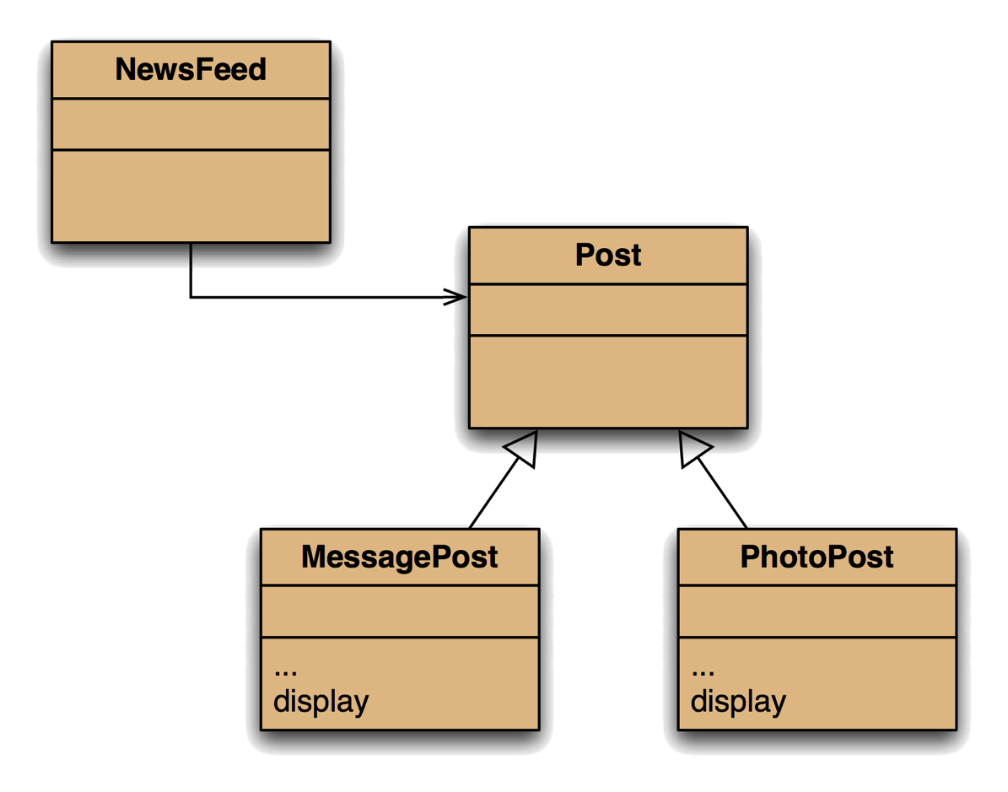
Attempting a Solution

Slide 17
Attempting a Solution
So we moved display to a spot where it can see all the instance variables it needed.

Slide 18
Attempting a Solution
But it turns out that it can't access those in Post at all (they're private).
So it has to access them via methods (which are public).

Slide 19
Attempting a Solution
But in any case, this solution breaks because NewsFeed can no longer see a display method at all.

Slide 20
Attempting a Solution
An (ugly) fix was to put a dummy method in Post:
public void display () {}
This does work, but is not the neatest way.

Slide 21
Static and Dynamic Type
To explain what is going on (and how to fix it), we need
some new concepts:
Static Type.
Dynamic Type.
Method Despatch / Lookup.
That is, how Java decides which method to call, bearing in mind we now have multiple methods with the same signature.

Slide 22
Polymorphic Variables
Object variables in Java are polymorphic.
This means they can hold objects of more than one type:
The originally declared type.
Any subtype of the declared type.
So it would be possible to declare a Post, and later turn it into a MessagePost.

Slide 23
Polymorphic Variables
Object variables in Java are polymorphic.
This means they can hold objects of more than one type:
The originally declared type.
Any subtype of the declared type.
Or, as we have seen, use a MessagePost where a Post is required.

Slide 24
Polymorphic Variables
Object variables in Java are polymorphic.
This means they can hold objects of more than one type:
The originally declared type.
Any subtype of the declared type.
But obviously an object has only one type at any point in time!
We can convert from one child type to another if needed.

Slide 25
Static and Dynamic Type
The declared type of a variable is its static type (Post).
The type of the object a variable refers at any point during runtime to is its dynamic type (MessagePost).
The compiler's job is to check for static-type violations (when we build the programme).
Dynamic-type violations tend to result in program failure (exceptions during operation)

Slide 26
The Solution
So this version was failing static type checking.
Our hack of the dummy method was just there to satisfy the compiler.

Slide 27

The Solution
But doing just that is actually close to the right solution.
We declare a display method in all three classes.

Slide 28
Overriding
The superclass and subclass define methods with the
same signature.
Each has access to the fields of its class.
The superclass method satisfies the static type check.
The subclass method is called at runtime: it overrides the superclass version.

Slide 29
Overriding
The superclass and subclass define methods with the
same signature.
Each has access to the fields of its class.
The superclass method satisfies the static type check.
The subclass method is called at runtime: it overrides the superclass version.
To understand how this works, we need to look out how Java decides which method to invoke on a method call: this is called method lookup.

Slide 30
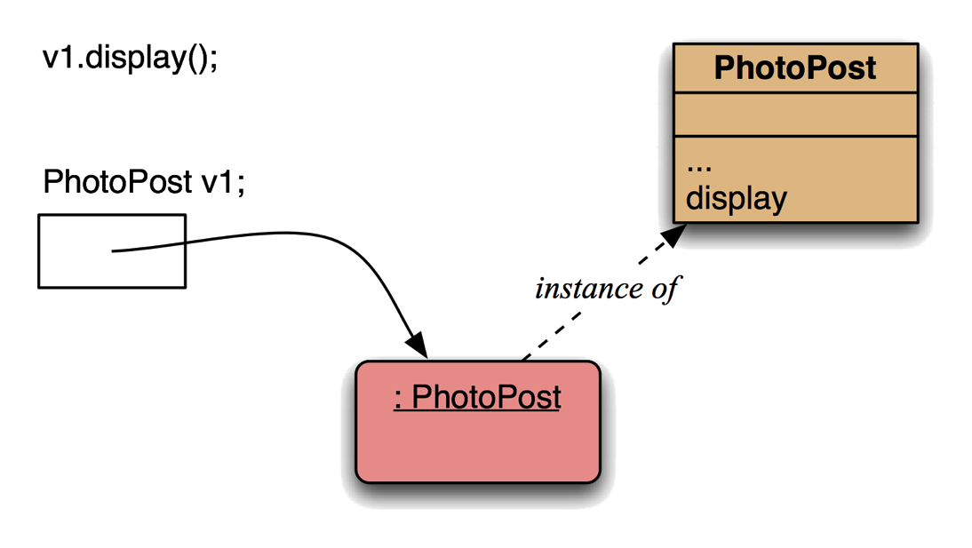
Method Lookup
Here the object is a PhotoPost, and this class defines the required method.
Nothing new here: no inheritance or polymorphism.

Slide 31
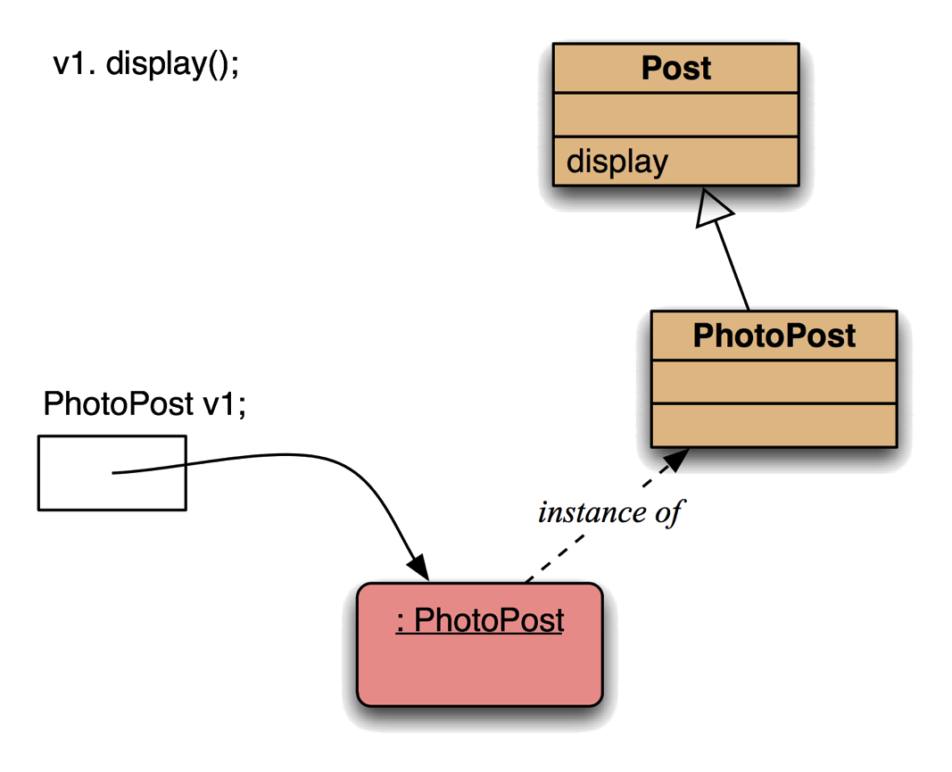
Method Lookup
Here the object is a PhotoPost, but this class does not define the required method.
But Post does, so that method is used.
This is simple inheritance.

Slide 32
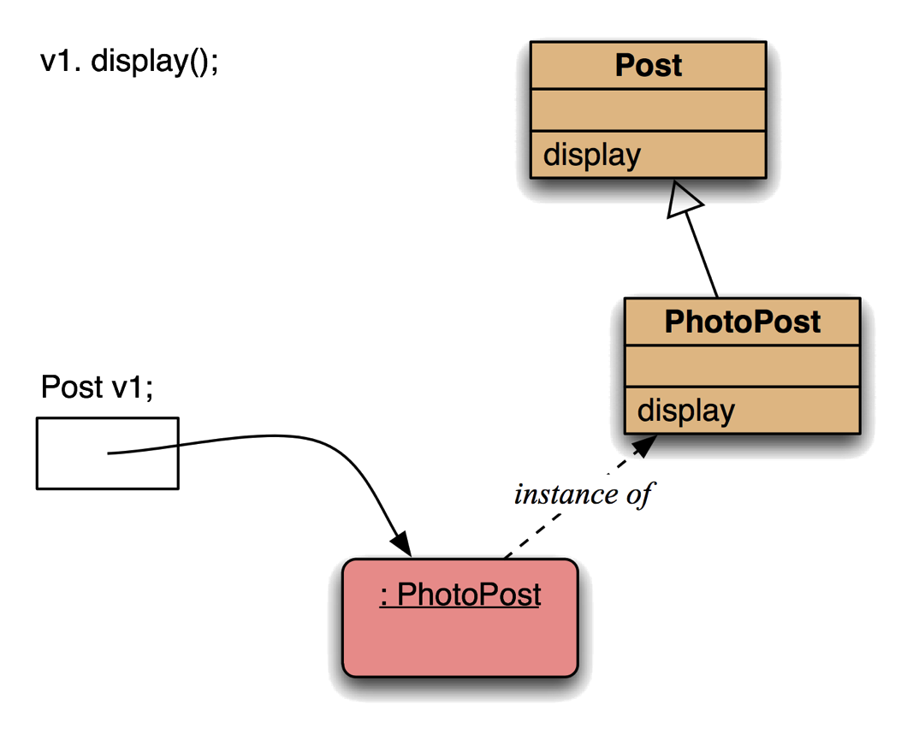
Method Lookup
Here the object is a PhotoPost which has a display method, as does Post.
We go up, seeking a match, and use the first one found.
This is polymorphism and overriding.

Slide 33
Method Lookup
Here the object is a PhotoPost which has a display method, as does Post.
We go up, seeking a match, and use the first one found.
(The method in Post never gets called.)

Slide 34
Method Polymorphism
We have been discussing polymorphic method dispatch.
A polymorphic variable can store objects of varying types.
Method calls are polymorphic:
The actual method called depends on the dynamic object type.

Slide 35
Determining Dynamic Type
It is often useful to "ask" an object what type it currently
holds (its dynamic type).
This is often used before a cast to determine if the cast will succeed:
if (post instanceof MessagePost) {
MessagePost msg = (MessagePost) post;

Slide 36
Determining Dynamic Type
It is often useful to "ask" an object what type it currently
holds (its dynamic type).
This is often used before a cast to determine if the cast will succeed:
if (post instanceof MessagePost) {
MessagePost msg = (MessagePost) post;
Note that this code will return true if the object is of the type given, or of any subtype.
It respects polymorphism.

Slide 37
Determining Dynamic Type
It is often useful to "ask" an object what type it currently
holds (its dynamic type).
This is often used before a cast to determine if the cast will succeed:
if (post instanceof MessagePost) {
MessagePost msg = (MessagePost) post;
A hack to subvert this is:
post.getClass ().equals (MessagePost.class)

Slide 38
Protected Access
In the current solution, the subclasses can display the instance variables from the superclass in two ways:
Using a super call to the display method of the superclass.
Displaying them using the public getter methods.
The subclasses cannot access the instance variables directly - they're private (or at least should be!!!).

Slide 39
Protected Access
In the current solution, the subclasses can display the instance variables from the superclass in two ways:
Using a super call to the display method of the superclass.
Displaying them using the public getter methods.
The subclasses cannot access the instance variables directly - they're private.
This is, of course, exactly what we want.
We do not want the subclass to rely on details of the implementation of the superclass.

Slide 40
Protected Access
In the current solution, the subclasses can display the instance variables from the superclass in two ways:
Using a super call to the display method of the superclass.
Displaying them using the public getter methods.
But this can be cumbersome, so if direct access is needed there is the protected access modifier.

Slide 41
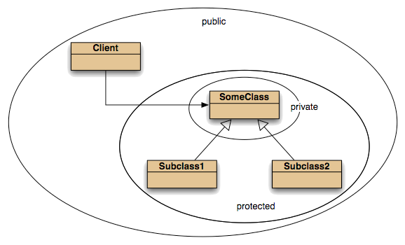
Protected Access

Slide 42
Protected Access
So with protected access, the subclasses can access the instance variables of their superclass.

Slide 43
Protected Access
This can be neat, but it subverts any checks in setter methods, so should be used with caution, if at all.

Slide 44
Protected Access
More formally, this breaks encapsulation.
Subclasses should ideally not know how the superclass is implemented.

Slide 45
The Solution

Slide 46
The Solution
This works, but we do have some duplicated code. In this case it can't easily be avoided unless we format the output in an unnatural way.

Slide 47
The Solution
And to minimise the possibly impact of changes in Post on its subclasses, we should use its public interface only.

Slide 48
Checking Dynamic Type
To get some neater output, we could remove the display method from Post, and check the dynamic type of the objects in the NewsFeed.

Slide 49
Checking Dynamic Type
To get some neater output, we could remove the display method from Post, and check the dynamic type of the objects in the NewsFeed.
The code would look something like this.
public void show () {
for (Post p : posts) {
if (p instanceof MessagePost) {
((MessagePost) p).display ();
}
else {
((PhotoPost) p).display ();
}
System.out.println ("------------");
}
}

Slide 50
Checking Dynamic Type
To get some neater output, we could remove the display method from Post, and check the dynamic type of the objects in the NewsFeed.
The code would look something like this.
This code is pretty scary (and we won't use it) but it does show how we could print just certain types of Post.
public void show () {
for (Post p : posts) {
if (p instanceof MessagePost) {
((MessagePost) p).display ();
}
else {
((PhotoPost) p).display ();
}
System.out.println ("------------");
}
}

Slide 51
Abstract Class
You might remember that we agreed that the Post class was abstract.

Slide 52
Abstract Class
Since we can't create a Post object, it follows that we will never call that display method!

Slide 53
Abstract Classes and Methods
Abstract classes cannot be instantiated.
They are denoted by adding the keyword abstract.
Likewise, abstract methods have abstract in the signature.
Abstract methods have no body.
But they satisfy static type checking.
Concrete subclasses complete the implementation.

Slide 54
Abstract Classes and Methods
Abstract classes cannot be instantiated.
They are denoted by adding the keyword abstract.
Likewise, abstract methods have abstract in the signature.
Abstract methods have no body.
But they satisfy static type checking.
Concrete subclasses complete the implementation.
Effectively, an abstract method commits every subclass to implement a method with that signature.

Slide 55
Abstract Classes and Methods
Abstract classes cannot be instantiated.
They are denoted by adding the keyword abstract.
Likewise, abstract methods have abstract in the signature.
Abstract methods have no body.
But they satisfy static type checking.
Concrete subclasses complete the implementation.
It's a concept we'll meet with interfaces next week.

